Slide 1

IRIS: ISP-Free RAW Image Semantic Segmentation
Course: CSE468 - Section 2
Group-11
Fatema Tabassum Elma(2222904042)
Arefin Amin (2221766642) Labiba Faiza Karim (2221454042) Ratul Hasan Ankon (2222568042)

Slide 2

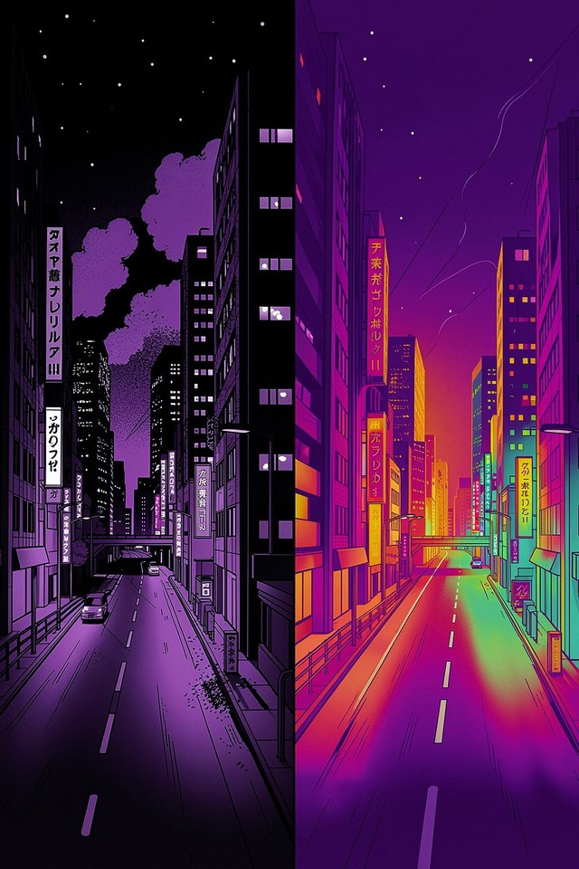
Why RGB-Based Vision Fails in Real Conditions
ISPcompression discards sensorinformation
Dynamic-range loss kills faint signals Noise patterns removed or altered Poor performance in low light / fog
Message: ISP pipelines that forms sRGB images discard critical data
Group number: 11, Group members: Fatema Tabassum Elma (2222904042), Arefin Amin (2221766642), Labiba Faiza Karim (2221454042), Ratul Hasan Ankon (2222568042)

Slide 3
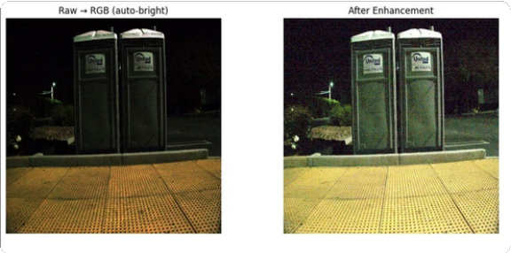
Learning Directly from RAW Data
Skip ISP 4operate on sensoroutput
Preserve fullinformation (broaddynamicrange,sensornoise) Train segmentation on RAW representations
Better robustness in adverse conditions
Message: More information ³ robust segmentation
Group number: 11, Group members: Fatema Tabassum Elma (2222904042), Arefin Amin (2221766642), Labiba Faiza Karim (2221454042), Ratul Hasan Ankon (2222568042)

Slide 4

Challenge: Missing Annotations in RAW
Limited pixel-levelannoted RAWdatasets
Some bounding-box labels of RAW data was available Manual pixel labeling is not scalable
Label gap blocks supervised training
Message: Lack of labels is the main barrier
Group number: 11, Group members: Fatema Tabassum Elma (2222904042), Arefin Amin (2221766642), Labiba Faiza Karim (2221454042), Ratul Hasan Ankon (2222568042)

Slide 5
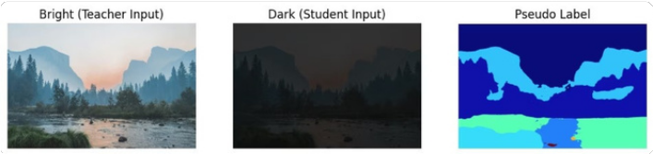




Pseudo-Labeling Strategy
³
Flow:BrightImage ³ Teacher Labels ³ Train
teachermodel ³ Train RAWModel
Message: Create labels without manual annotation
1
2
3
4
1. Teacher on bright RGB
2. Generate pseudo labels
3. Transfer to RAW
4. Train RAW student
High-quality segmentation predictions
Per-image labels from teacher outputs
Align labels with RAW sensor frames
Student learns from pseudo supervision
Group number: 11, Group members: Fatema Tabassum Elma (2222904042), Arefin Amin (2221766642), Labiba Faiza Karim (2221454042), Ratul Hasan Ankon (2222568042)

Slide 6
RAW
Preprocess
Bayer ³ 4-channel conversion
Teacher Inference
Bright RGB segmentation output
RAW Student Training
Train on RAW with pseudo-labels
Dark3Bright Pairing
Match low/high exposure frames
Pseudo-Labels Generate labelsfrom teacher outputs
Caption: End-to-end processing chain 4 sensor-level input to trained RAW segmentation model.
Group number: 11, Group members: Fatema Tabassum Elma (2222904042), Arefin Amin (2221766642), Labiba Faiza Karim (2221454042), Ratul Hasan Ankon (2222568042)

Slide 7
Key Technical Insights
4-channelRAW representationretainssensor sampling No demosaicing ³ no interpolation losses
Transformer backbone (SegFormer) adapted to RAW inputs Transfer learning tailored for sensor domain
Message: We exploit sensor-level data for robustness
Group number: 11, Group members: Fatema Tabassum Elma (2222904042), Arefin Amin (2221766642), Labiba Faiza Karim (2221454042), Ratul Hasan Ankon (2222568042)

Slide 8
Results
Limitations
Teacher errors canpropagate
Domain gap:RGB ³ RAWalignment issues Small dataset; limited augmentation
Improvedsegmentation in low light
More robustthan RGB baselines Better utilization of sensor cues
Message: Strong gains, constrained by supervision and data
Group number: 11, Group members: Fatema Tabassum Elma (2222904042), Arefin Amin (2221766642), Labiba Faiza Karim (2221454042), Ratul Hasan Ankon (2222568042)

Slide 9

Future Directions
Improve pseudo-labels
Domain adaptation
Bridging RGB RAWfeature spaces
Confidence-basedfiltering&ensemble teachers
Scale datasets
End-to-end RAW training
DiverseRAWcaptures + synthetic augmentation
Remove dependence on RGB teacher
Group number: 11, Group members: Fatema Tabassum Elma (2222904042), Arefin Amin (2221766642), Labiba Faiza Karim (2221454042), Ratul Hasan Ankon (2222568042)

Slide 10
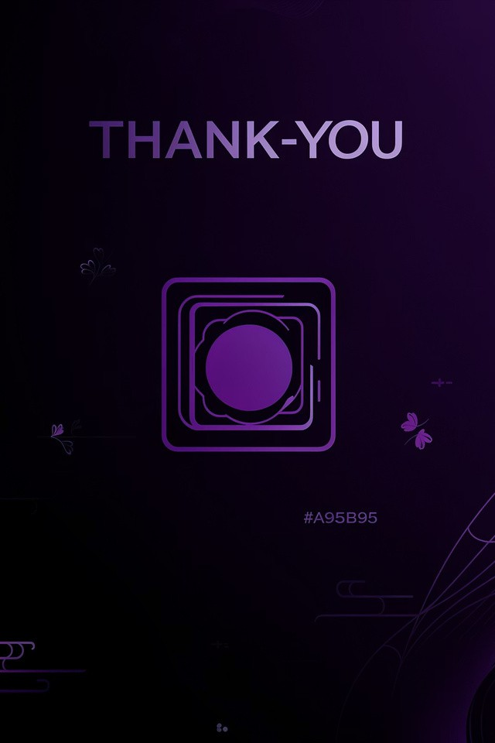

Thank You
PROJECT: IRIS
Group number: 11, Group members: Fatema Tabassum Elma (2222904042), Arefin Amin (2221766642), Labiba Faiza Karim (2221454042), Ratul Hasan Ankon (2222568042)

